Slide 1
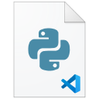

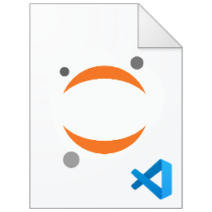
VSCode Python Installation
VSCode <3 Python.
Pandas X Matplotlib X Jupyter X Scikit-Learn X TensorFlow X PyTorch
#MEI 00881036 TaiXeflar

Slide 2
Python Installation
We strongly recommend base hardware requirement on your PC:
CPU : Intel Pentium / AMD Athlon 2 Core @1.5GHz (require Hyper-Threading)
GPU: Intel UHD / AMD Radeon integrated Graphics
RAM : 4GB DDR4
Storage : 128GB SSD
OS: Windows 10 / Windows 11
Example: ASUS X412FA (Laptop)
CPU: Intel Core i5-8265U @2.5GHz 4 Core, 8 Threads
GPU: Intel UHD 630
RAM: 4+4 GB DDR4 Dual Channel
Storage: Intel 660P Series 512GB M.2 NVMe PCIe 3.0 SSD
OS: Windows 10

Slide 3
Python Installation
We recommend intermediate hardware specs on your PC:
CPU : Intel Core / AMD Ryzen 4 Core @2GHz or higher (require Hyper-Threading)
GPU: NVIDIA discrete GPU @2GB GDDR5 (Support NVIDIA CUDA)
RAM : 8GB DDR4 (recommend 16GB)
Storage : 512GB SSD
OS: Windows 10 / Windows 11
Example: ASUS X412FL (Laptop)
CPU: Intel Core i5-8265U @2.5GHz 4 Core, 8 Threads
GPU: Intel UHD 630, NVIDIA GeForce MX250 @2GB GDDR5
RAM: 4+4 GB DDR4 Dual Channel
Storage: Intel 660P Series 512GB M.2 NVMe PCIe 3.0 SSD
OS: Windows 10 / Windows 11

Slide 4
Python Installation
We recommend medium-high end hardware specs on your PC:
CPU : Intel Core / AMD Ryzen 6 Core @2GHz or higher (require Hyper-Threading)
GPU: NVIDIA discrete GPU @4GB GDDR5/GDDR6 (Support NVIDIA CUDA)
RAM : 12GB DDR4 (recommend 16GB)
Storage : 512GB SSD
OS: Windows 10 / Windows 11

Slide 5
Python Installation
PC | CPU (of Cores/Threads) | GPU (of GPU/VRAM) | RAM | SSD | OS | Environment
Basic | 2 Cores, 4 Threads | iGPU | 8GB | 128GB | Windows 10 | Colaboratory
Medium | 4 Cores, 8 Threads | NVIDIA, 2GB | 8GB | 128GB | Windows 10 | Colaboratory Local
Performance | 6 Cores, 12 Threads | NVIDIA, 4GB | 12GB | 256GB | Windows 10 | Colaboratory Local
Note:
SSD either SATA or PCIe interface can provide faster boot loading, virtual memory, system cache loading speed than Hard Drive Disk.
Hyper-Threading technology enable 1 core for 2 Threads. Based on CPU architecture and BIOS/UEFI setup. For Intel Core 12th Gen CPUs contains P-core and E-core with only P-core support Hyper-Threading. Cores/Threads may be different.
iGPU is integrated GPU, such as Intel UHD, Intel Iris Xe, AMD Radeon Graphics in same package to CPU.
Discrete GPU condition requires CUDA GPU acceleration support. CUDA capable may different to your GPU setup.
RAM requires at least 4GB. Additional RAM add-on depends on Motherboard design. Recommend RAM set up is Dual-Channel Memory for data transfer more faster.

Slide 6
Python Installation
We list released Python package for selection:
Provider | IDE | Environment | Package
Python Foundation | ---- | Default | Python installer
Microsoft | Visual Studio | Default | Visual Studio Installer
Intel | ---- | Conda | Intel oneAPI
Anaconda | Spyder | Conda | Anaconda

Slide 7

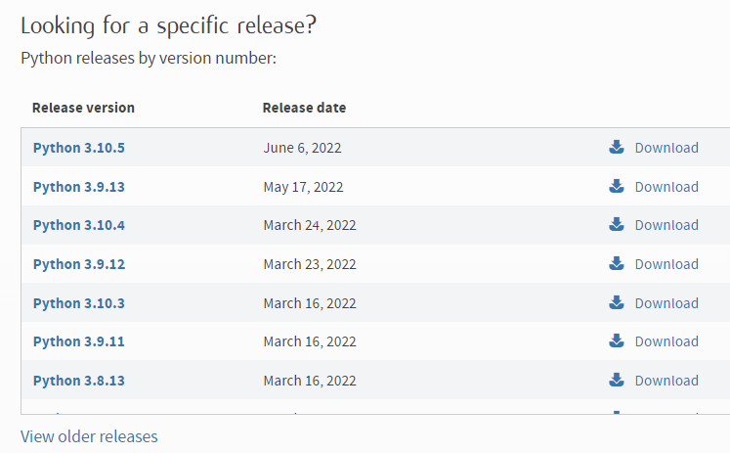
Python Installation
Go to Python official website, click download and find release which is fits your need.
Stable build version recommend 3.7.9, 3.9.5 or 3.9.7.
If you use terminal (command line) to install Python package, you will get the latest version.
PS> winget install python

Slide 8
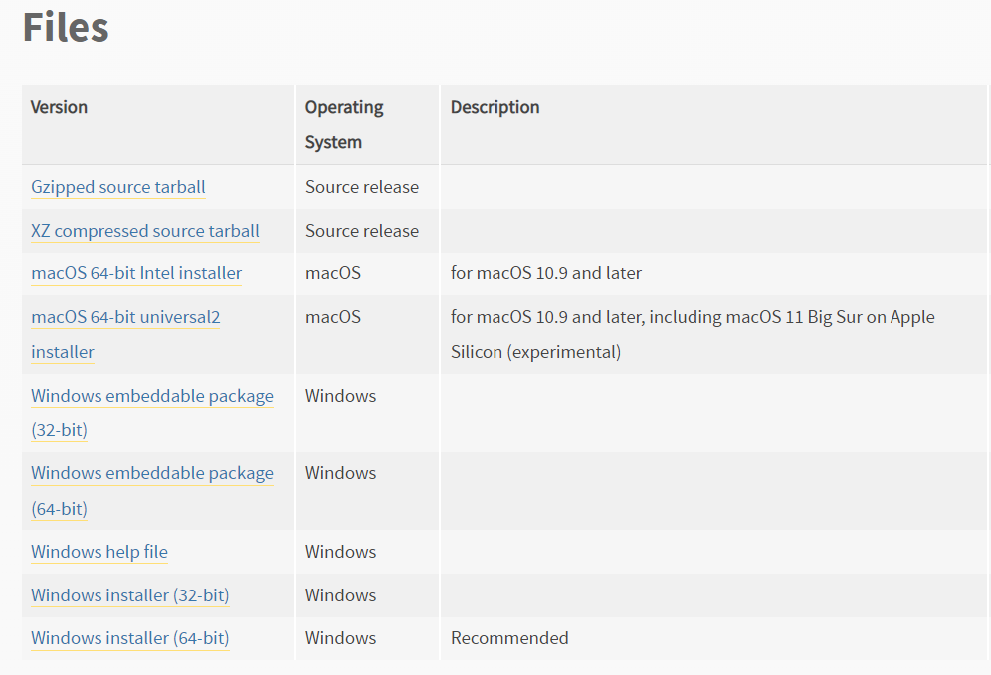
Python Installation
Find out your selected version, click to download.
Python package is a executable installer, it will guide you to finish whole Python installation.

Slide 9
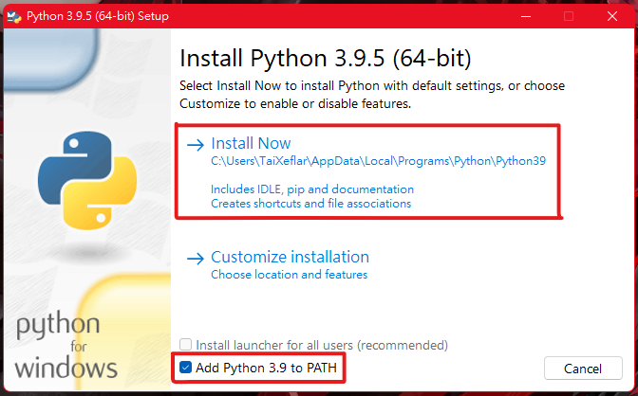
Python Installation
Click on “Install Now”.
“Add Python to PATH” options enable python install path write to your User Variables.
“Install launcher for all users” options will change install location to System(Program Files). Thus, Path option will change to System Variables.

Slide 10


VSCode Installation
Now we begin our Python develop tasks in Visual Studio Code.
Visual Studio Code is an light weight, high extension and open source text editor from Microsoft. You can self-customize editor references, develop environment by just adjusting JSON file key pair values and parameters.
Happy Coding and Get It Now.

Slide 11
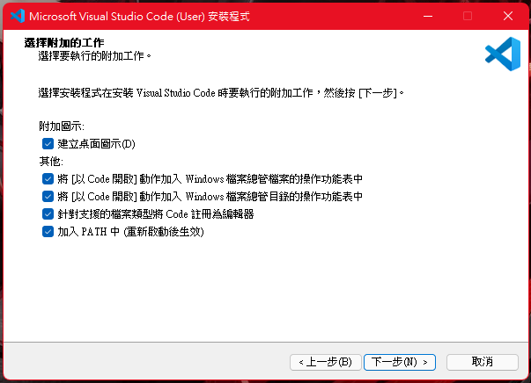
VSCode Installation
Register VSCode as supported files editor. This will enable open code files with vscode as default.
Add to PATH will enable shell environment (PowerShell, CMD) by execute “code .” command to launch VSCode in target folder.
VSCode have two versions installer for User or System installer. Please note the difference will cause install location in different path.

Slide 12
Python Installation
This is User install PATH location:
C:/Users/YOU/AppData/Local/Programs/Python/Python39
C:/Users/YOU/AppData/Local/Programs/Python/Python39/Scripts
This is System install PATH location:
C:/Program Files/Python39
C:/Program Files/Python39/Scripts

Slide 13
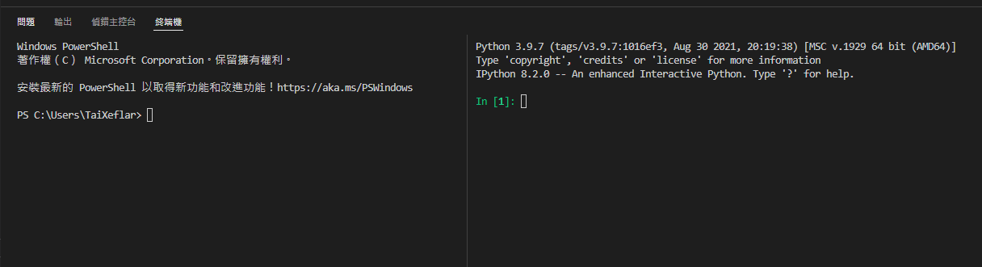
VSCode Introduction
Just like other IDEs, VSCode can open terminal at same time to both python debug and execute shell commands and a interactive python standby.
We will set up these settings in settings.json .

Slide 14
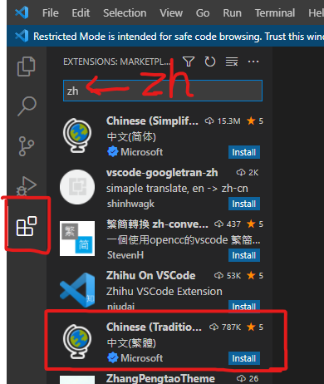
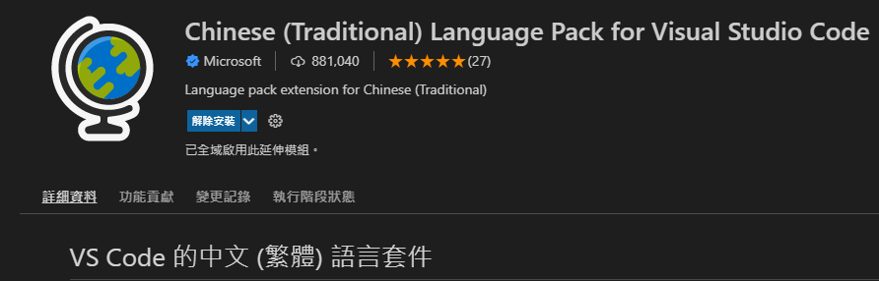
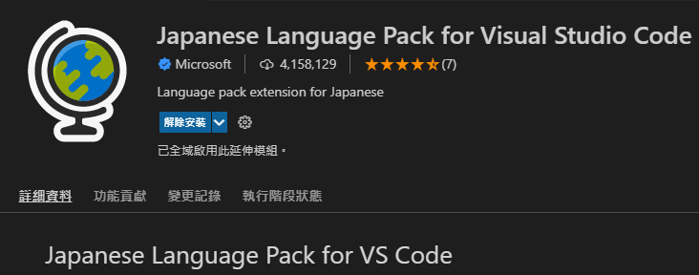
VSCode Installation
Enter VSCode, go to extensions, find your language pack.
If you persist for English interface, you can pass recommend install messages or disable it after install.

Slide 15
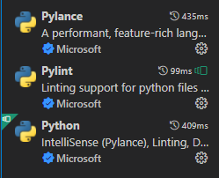
VSCode Python Extension Installation
Install Extensions:
Python
Pylance
Language Pack: (Optional)
Traditional Chinese Language Pack
Japanese Language Pack

Slide 16
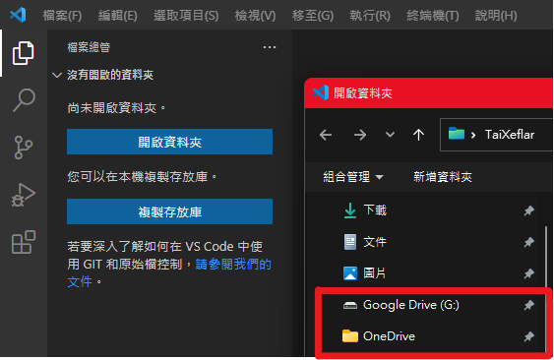
VSCode Introduction
Click Explorer, open where your project folder is.
Whether your restricted D:/Pixiv/R18/ folder or your small mount cloud drive can open for it.
Hotkeys:
Open Folder: “Ctrl+K” + “Ctrl+O”
Close Folder: “Ctrl+K” + “F”

Slide 17
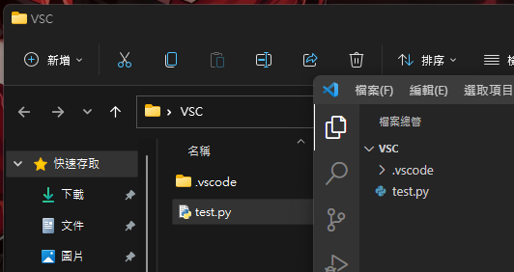
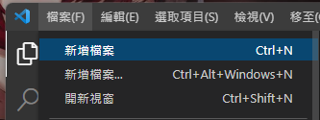
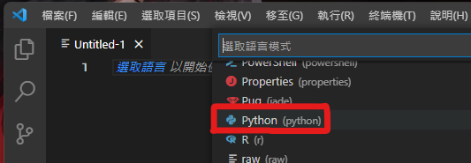
Python Coding
Create a new file, then set a language would you like.
Make sure your file must be saved in project folder you ordered. Also, Python file(.py) must be saved to debug.

Slide 18
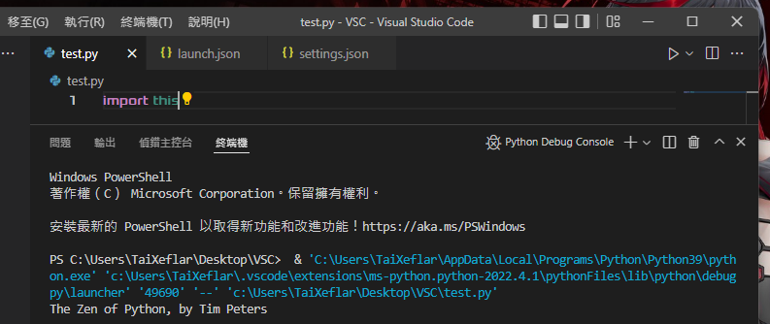
Python Debugging
Press “F5” to debug your Python file.
In default, debug logs will print in a new integrated terminal.

Slide 19






Python Scripts Installation
We need to install “Scripts” to extend our Python module.
Python “Scripts” just like Mods in Minecraft, use Forge or Fabric to load Mods make Minecraft more playable then the Vanilla Minecraft.
Warning! Some scripts/module provide parallel compute or CUDA acceleration by requires supported GPUs. Please make sure scripts that you installed must fit to your hardware and software. Example: Torch(PyTorch), TensorFlow, CuPy, Numba
Core | Package Manager | MODS
Vanilla Minecraft | Forge/Fabric | Mods
Python | Conda/pip | Scripts

Slide 20
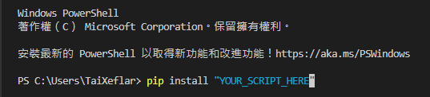
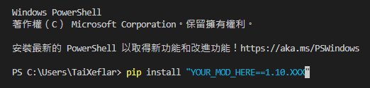
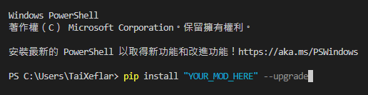
Python Scripts Installation
We use pip as Python’s Package Manager. PIP requires shell environment to download and install scripts.
If your Python Environment is installed for System, you need to run an elevated command prompt (Administrator) to install Python Scripts.

Slide 21
Python Scripts Installation
Install Python “MOD” Scripts:
pip install MOD
Install Python “MOD” Scripts with specified version:
pip install MOD==XX.X.X
Install Python “MOD” Scripts upgrade:
pip install MOD --upgrade
Install Python “MOD” Scripts with multi Scripts:
pip install MOD1, MOD2, MOD3
Uninstall Python “MOD” Scripts:
pip uninstall MOD

Slide 22
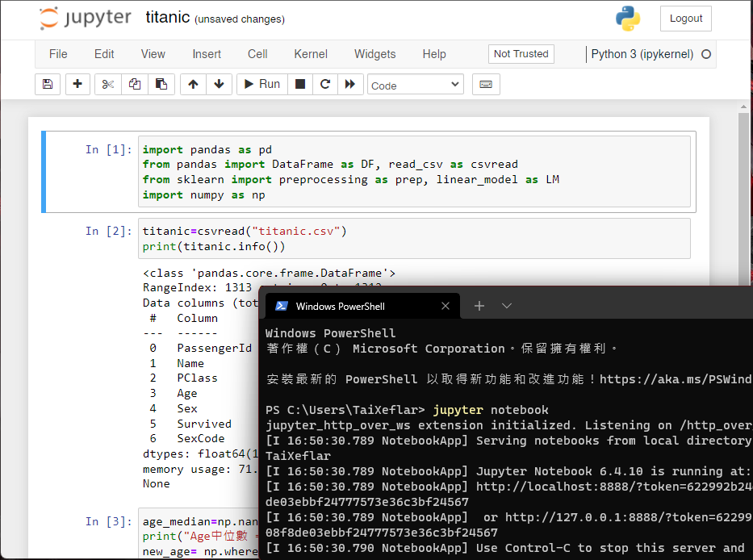
Introducing Python Jupyter Notebook
Jupyter Notebook is based on ipykernel, stage debug Python environment.
When running Jupyter Notebook, ipykernel will run in terminal and build up virtual environment. Warning: Kill or close the terminal will cause localhost ipykernel interrupt.

Slide 23
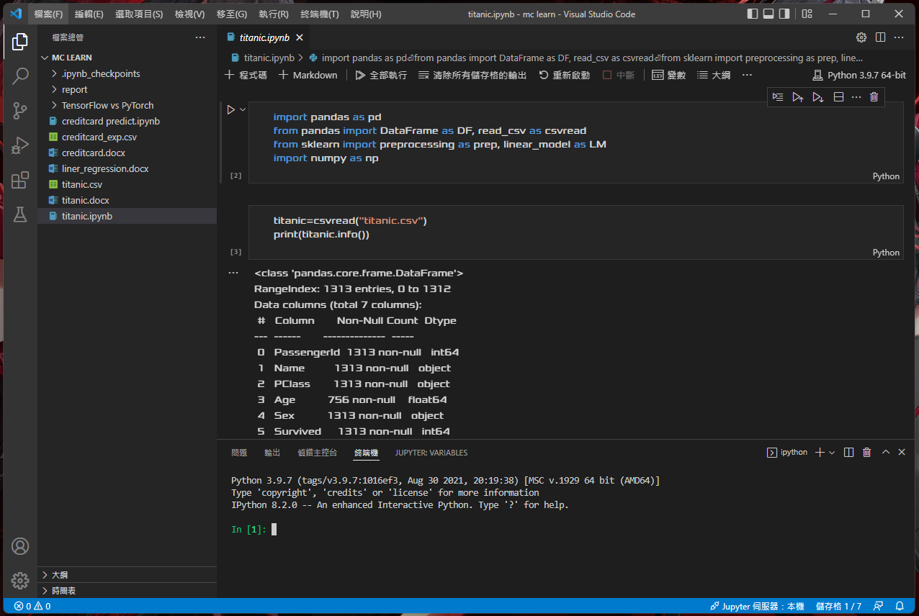
VSCode <3 Jupyter Notebook
VSCode can run Jupyter Notebook with two advanced advantage:
No need to open new terminal
Addition call new iPython for multi test

Slide 24
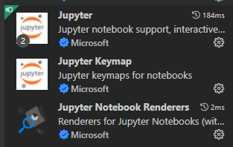
VSCode Jupyter Notebook Installation
Install Jupyter Notebook extensions:
Jupyter
Jupyter Keymap
Jupyter Notebook Renderers

Slide 25
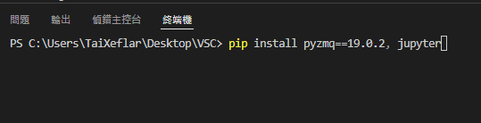
VSCode Jupyter Notebook Installation
Build up Jupyter Notebook requires listed Scripts:
pyzmq==19.0.2
Jupyter
We use this command to install Jupyter:
PS> pip install pyzmq==19.0.2, jupyter

Slide 26
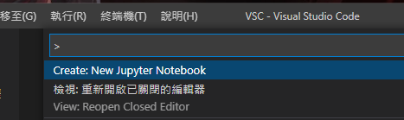
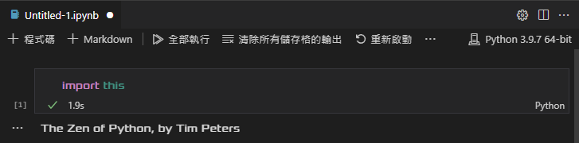
VSCode Jupyter Notebook Coding
Press Hotkey “Ctrl + Shift + P” to run command, type “New Jupyter Notebook”:
Cell execute successfully should look like this:
Execute “Cell” code hotkey is:
“Shift + Enter”

Slide 27
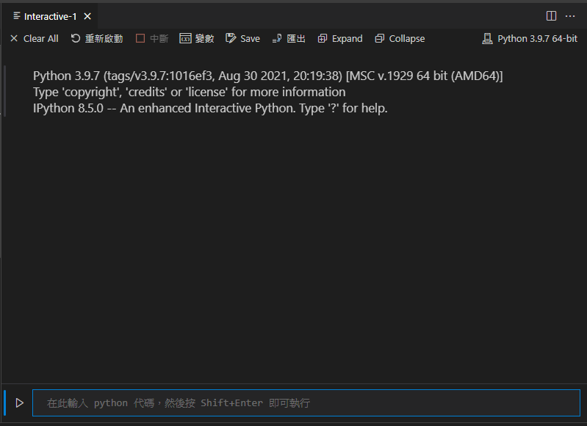

VSCode IPython Console (Interactive Window)
Now we set our iPython console: Press Hotkey “Ctrl + Shift + P” and find Jupyter sections, select “Create Interactive Window”.

Slide 28

VSCode IPython Console (Terminal)
Now we set our iPython console: Press Hotkey “Ctrl + Shift + P” to open VSCode preferences: Open settings (JSON).

Slide 29
VSCode IPython Console
Find or generate key pair value “terminal.integrated.profiles.windows” and add new json object “iPython”.
“iPython”: (For Python Scripts installed for Users) { “path”:[“C:/Users/USER/AppData/Local/Programs/Python/Python39/Scripts/ipython.exe”, "C:/Users/USER/AppData/Local/Programs/Python/Python39/Scripts/ipython3.exe"] }
“iPython”: (For Python Scripts installed for System) { “path”:[“C:/Program Files/Python39/Scripts/ipython.exe”, " C:/Program Files/Python39/Scripts/ipython3.exe "] }
#USER is your name。

Slide 30
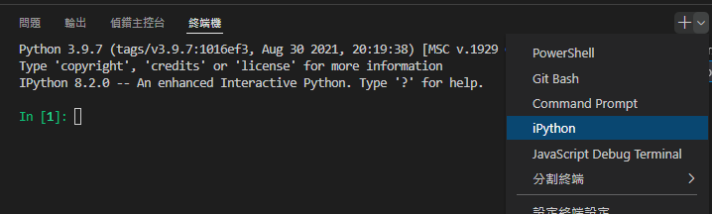
VSCode IPython Console
Now you can either coding and interacting。

Slide 31
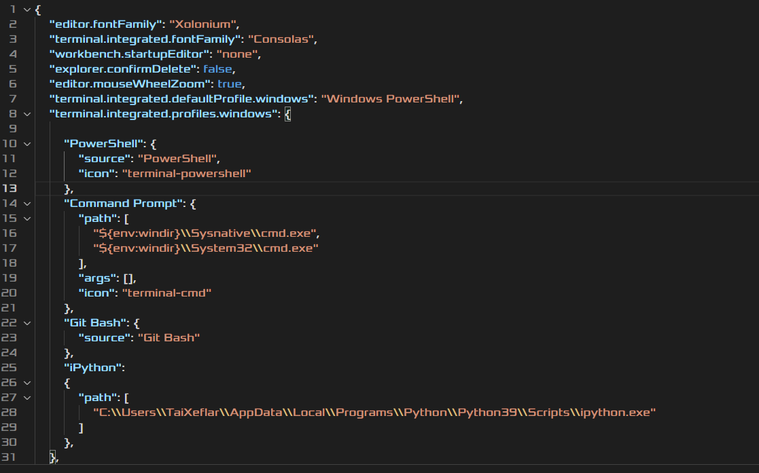
VSCode Customization
We use settings.json to continue customize VSCode user interface:
“editor.fontFamily”: Value must be installed Fonts.
“terminal.intergrated.fontFamily”: Value must be installed Fonts.
“editor.mouseWheelZoom”: Value must be Boolean. This function is use Ctrl+Mouse Wheel to zoom text size.

Slide 32
Appendix – Python Module
Data Science
Math(built-in)
Matplotlib
NumPy
Pandas (include NumPy)
Scikit-learn
Microsite
Flask
Bottle
Jinja
Django
Web Crawler
BS4(Beautiful Soup)
Deep Learning
JAX
TensorFlow(TF)
PyTorch(Torch)
PyKokkos (Kokkos) [Linux]
Raja(RAJⱯ) [Linux]
Discord
Discord(Discord Bot)
Interactive Python
IPython
Jupyter(include IPython)
Google.Colab [Linux]
Only Colaboratory
Drive

Slide 33
Appendix – Python Packaged Version
Anaconda
Python 3.7.8 (Conda)
Python 3.8.8 (Conda)
Google Colab
Python 3.6.9 (Special Version for Linux)
Python 3.7.13 (Special Version for Linux)
Microsoft Visual Studio (VS)
Python 3.7.9 (VS 2019)
Python 3.9.5 (VS 2022)
Python 3.9.7 (VS 2022)
Intel oneAPI distributed Python
Python 3.9.10 (Conda)

Slide 34
Endnotes – Download Links
Python Website: https://www.python.org/downloads/
Anaconda: https://www.anaconda.com/products/distribution
VS2022 Download: https://visualstudio.microsoft.com/zh-hant/
VSCode Download: https://code.visualstudio.com/
Intel Distribution for Python: https://www.intel.com/content/www/us/en/developer/articles/tool/oneapi-standalone-components.html#python
Reference Source:
https://code.visualstudio.com/docs/python/python-tutorial
https://code.visualstudio.com/docs/datascience/jupyter-notebooks

Slide 35
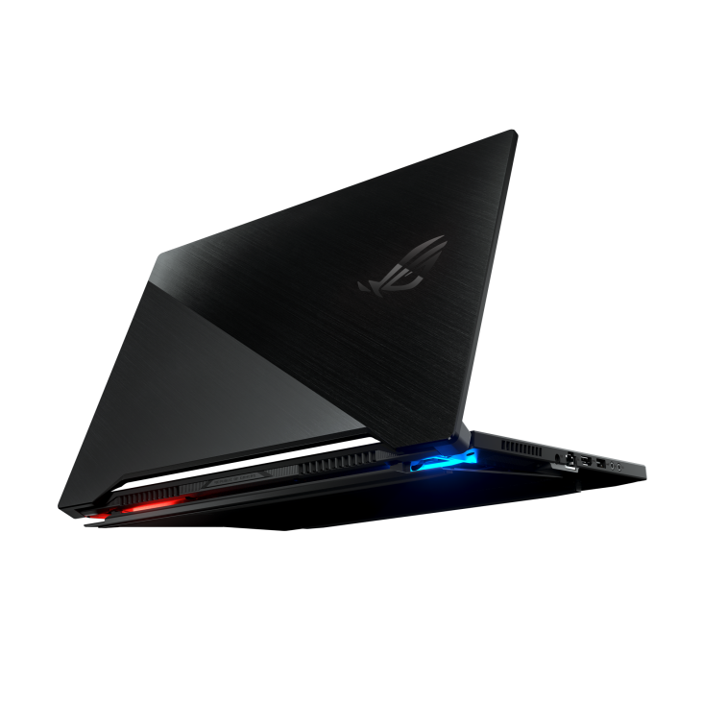
Endnotes – Tested Environment
Tested Environment: ROG Zephyrus S15 2020 (GX502LXS)
CPU: Intel Core i7-10875H @2.3GHz 8 Cores 16 Threads
iGPU: Intel UHD Graphics
GPU: NVIDIA GeForce RTX 2080 Super with Max-Q Design @8GB GDDR6
WHQL Driver: GeForce Game Ready Driver 512.96
RAM: Micron 32GB 3200MHz Dual channel memory
Storage: Samsung 970 Evo Plus 2TB SSD x2 3500/3300 MB/s
Operating System: Windows 11 Home Edition
Windows 11 21H1 Pro Workstation Edition 1000.22000.778.0 Stable Build feature Experience Pack

Slide 36
Endnotes
Hardware recommendations are for reference only and requires may be different in action by system usage and foreground/background application usage. Higher hardware requirement ensure system provides more CPU calculations, RAM space and disk load speed. Dual-Channel memory provide faster data transfer speed. High RAM volume enables project RAM usage can more larger. SSDs either SATA or PCIe interface are more faster(Boot loading, Virtual Memory, System Cache) than HDD. SSD load speed may effect by PCIe interface and RAID Volume.
This PowerPoint is only for development and education usage. Any company, product logos are for informational purposes only and may be trademarks of their respective owners.
This PowerPoint result is tested done by ROG Flow Z13 2022 edition and ROG Zephyrus S15 2020 edition with specified hardware additions in 7/5/2022. For further specified hardware details refer to Endnotes – Tested Environment.
Visual Studio Code, VSCode, Visual Studio Code logo, Visual Studio, VS2022, VS2019, VS2017, Visual Studio logo, Windows 10, Windows 11 are registered logo, trademarks and products of Microsoft Corporation.
Intel Core 12th Gen CPUs contains P-core and E-core with only P-core support Hyper-Threading cause CPU Threads may not be full 2x than CPU cores. Intel distributed Python is special Conda environment release from Intel oneAPI toolkit. Intel, Intel oneAPI, Intel Core, Intel Pentium, Intel UHD, Intel Iris Xe , Intel 660p series SSD and other Intel Products are registered logo and trademarks of Intel Corporation.
AMD Radeon GCN, RDNA series GPU architecture not support CUDA acceleration. AMD, AMD Ryzen, AMD Athlon, AMD Radeon Graphics series and other combinations thereof are products and trademarks of Advanced Micro Devices, Inc.
Deep Learning toolkit Python scripts may requires CUDA toolkit, CUDA runtime, cuDNN libraries and CUDA compatible NVIDIA GPU. NVIDIA, NVIDIA logo, GeForce, Quadro, Titan, MX, GTX, RTX, CUDA, cuDNN are trademarks and products of NVIDIA Corporation.
Anaconda, Anaconda Distributed Python, Anaconda logo, Conda and Miniconda are registered logo of Anaconda Inc.
Python, Python logo are registered logo of Python Foundation.
Google, Google Colaboratory and Google Drive are combinations thereof are trademarks of Google Inc.

